Slide 1
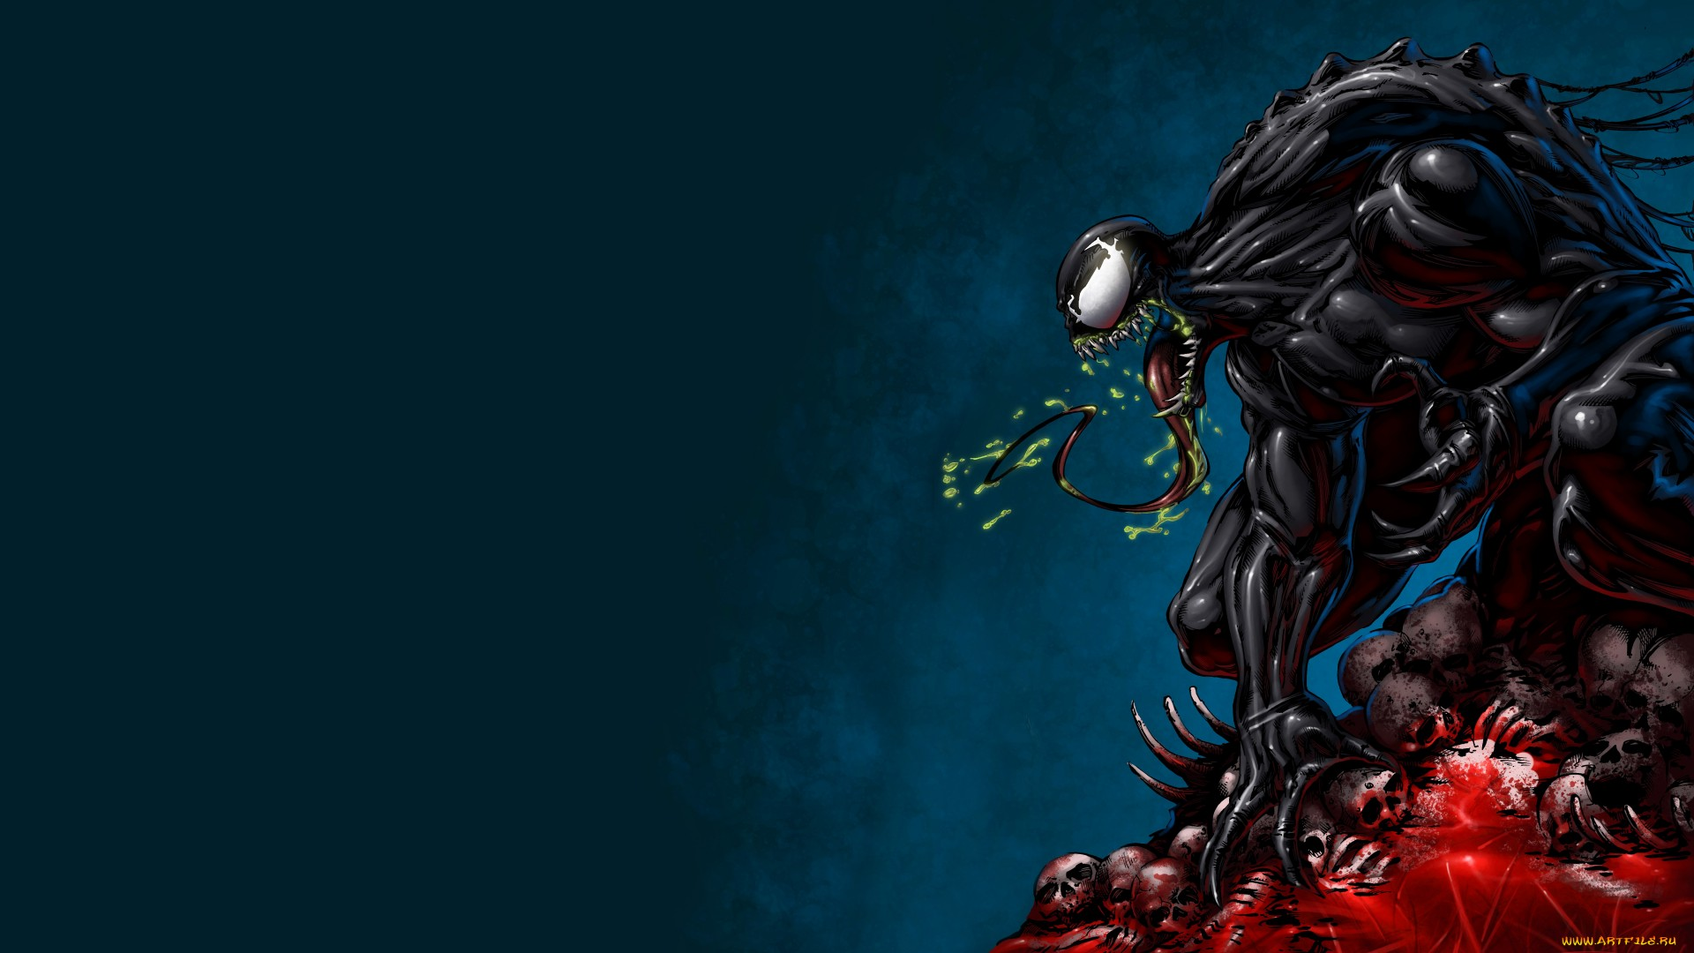
DEEP/DARK WEB FOR RED TEAM OPS

Slide 2

WHO AM I?
Threat Intelligence Researcher
Threat Intel Blog: THE RAVEN FILE
GitHub: THE RAVEN FILE
Twitter: RakeshKrish12
THERAVENFILE.COM

Slide 3
INDEX
DARK VS DEEP WEB
DARK WEB MYTH BUSTING
MAINTAINING ANONYMITY
TARGET RECONNAISSANCE: RED TEAM APPROACH
RED TEAM PREPS: DARK/DEEP SOURCES
TELEGRAM EXPLORE: OFFENSIVE
WHAT AFTER ACCESS? POST EXPLOITATION
SECTION 66 IT ACT: A JOKE
PHISHING
RANSOMWARE DARKWEB WALKTHROUGH
CORPORATE STORY TIME

Slide 4

DARK VS DEEP
DARK WEB = !BLACK SCREEN
Only accessible via TOR, I2P (.onion Domains)
TORBOT – Crawler
OnionScan – Scanner for availability
Ahmia.fi
DEEP WEB: Login Prompts, Paywalls, TG Channels, Discord Servers
Infostealer, CVV
Restricted & Unrestricted stuffs equally pop-up
Includes DDoS, Social Hack, 0-Day Exploits etc
Accepts payment in Crypto (BTC, XMR, ETH)
Main Order: DDoS as Service, Exploits
Uses BPH to host on Clear Web
Guarded with Cloudflare services to conceal identity

Slide 5
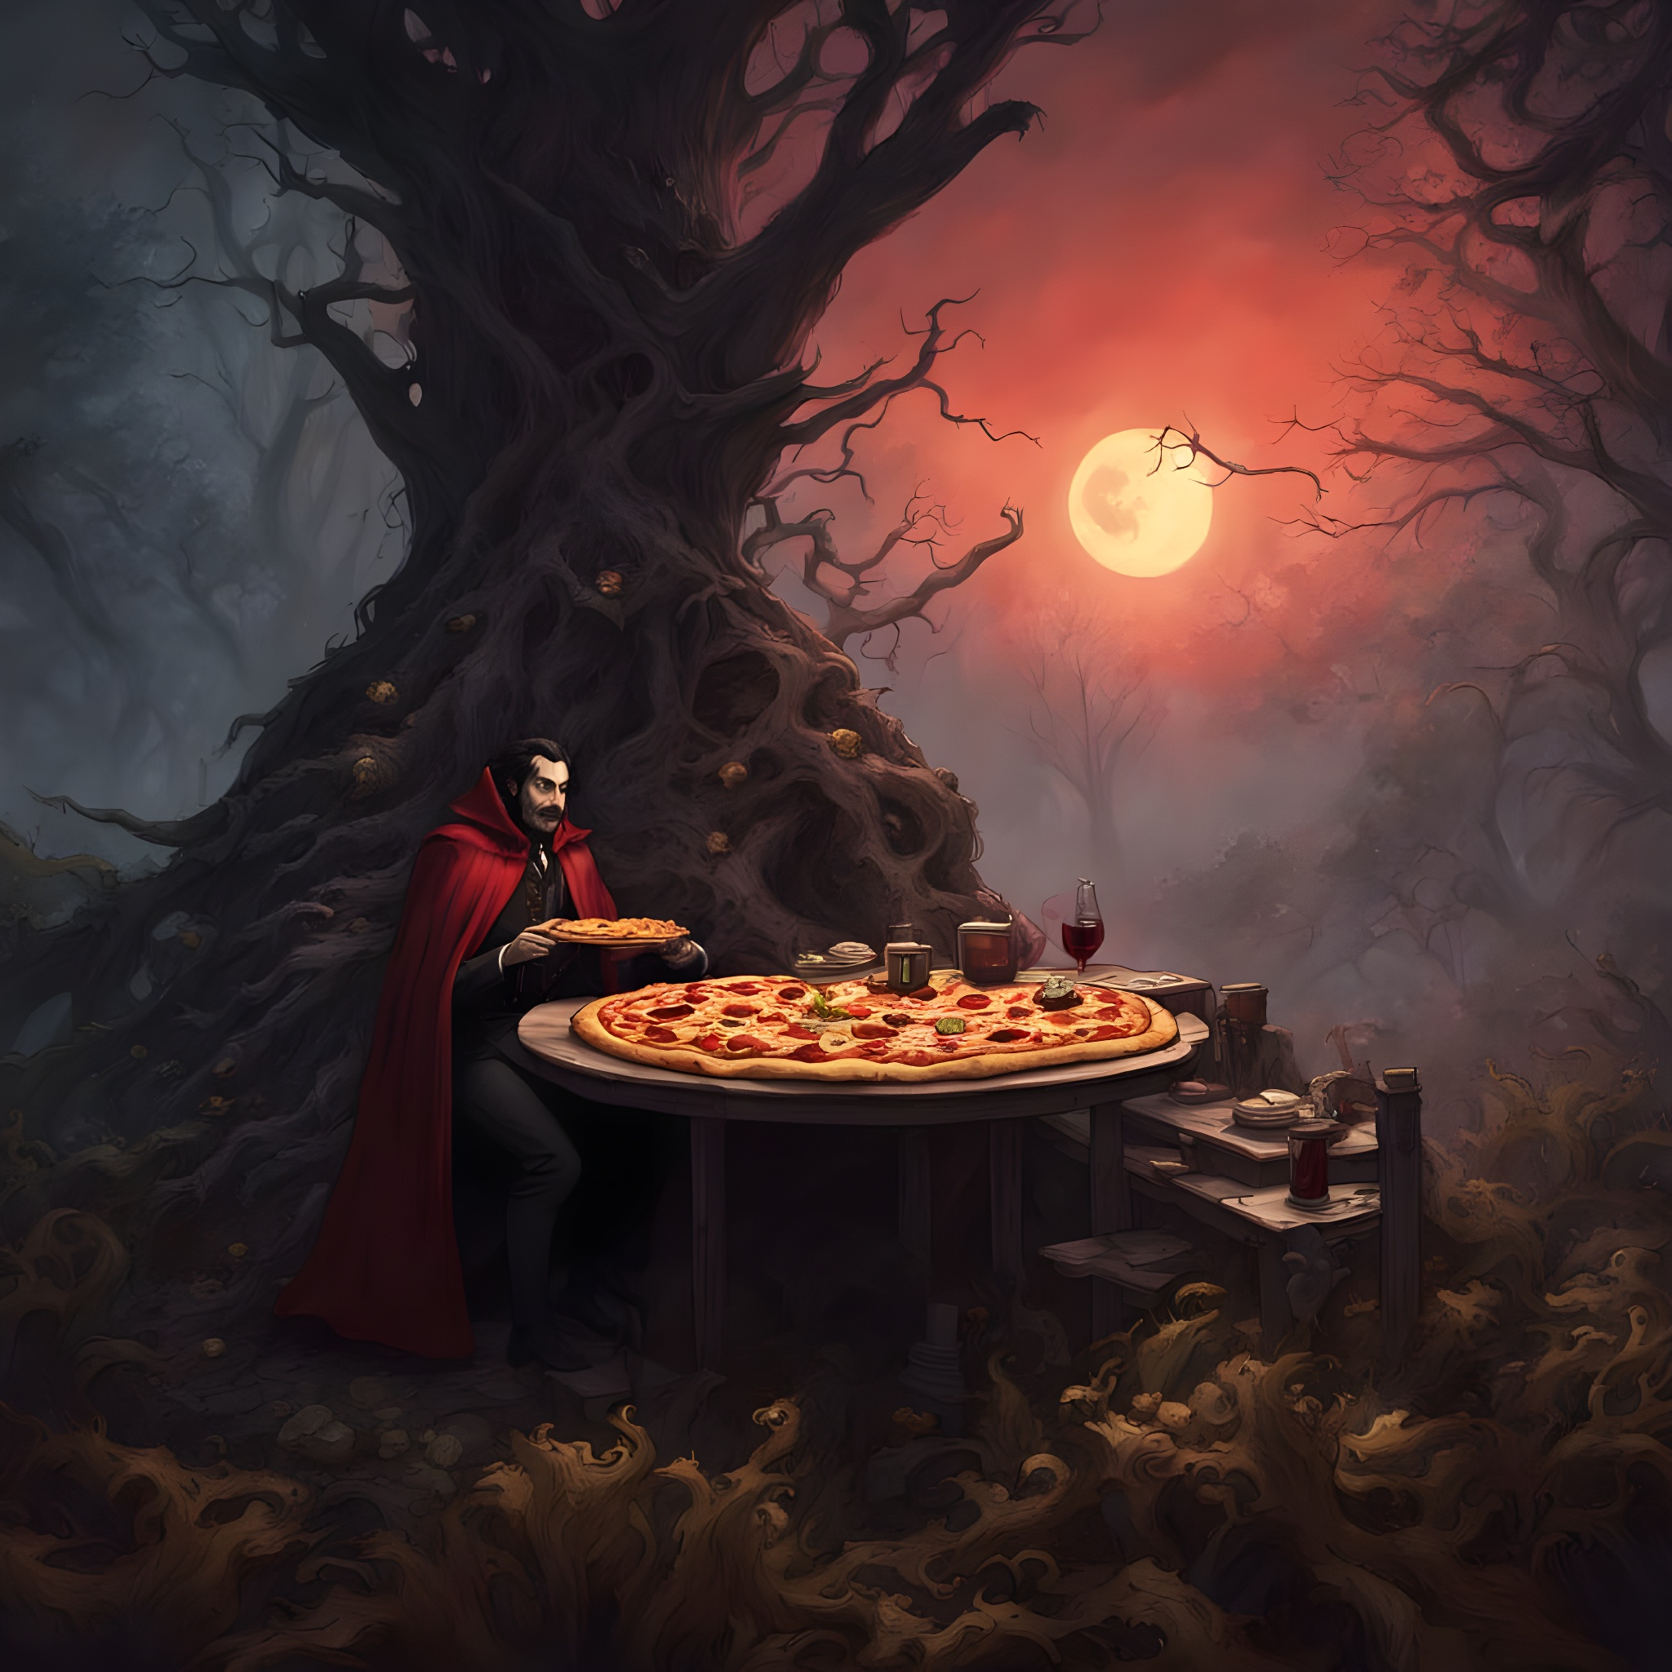
DARK WEB MYTH BUSTING
NOT a Dangerous Place
Myth: RED ROOMS
No Geographical Targets among Hackers except in Espionage Operations/APT Groups/CIS Ransomware Groups
Very few APT/Ransomware Groups use their own custom tools. Rest uses Open Source tools effectively
Once a breach is out, it never gets taken down from the Internet
Crypto Recovery is almost impossible
Untraceable: Sorry, NO!

Slide 6

MAINTAINING ANONYMITY
Passive Participant
Multiple – SOC PUPPET
Never express your favorites
Usage of Temporary Emails
Minimize OPSEC Failures
VPN: Optional
While conversing, maintain a warm Rapport. Generally abusive, but hold your horses!
RUSSIA – Your Friend!
ARTICLE: https://theravenfile.com/2025/09/08/uncovering-alviva-holding-links-to-russian-shell-companies-and-cybercrime/

Slide 7

TARGET RECONNAISSANCE: RED TEAM OPS
Breach Detection of Corporate Emails
Target Domain Scanning: ACTIVE & PASSIVE
Dark Web Forum and TG Channels
Shodan, Censys, FOFA etc
Tech Stack Detection via Job Portals
General News

Slide 8
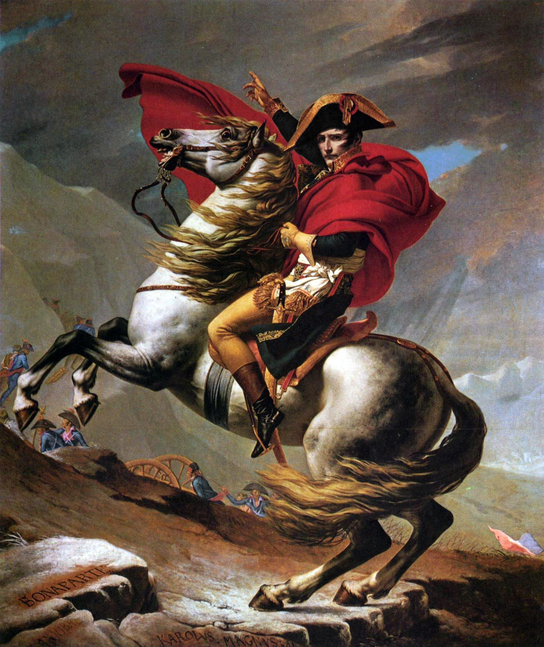
RED TEAM PREPS: DARK/DEEP SOURCES
Most attack tools: GitHub
Password should be Random Generated
Phishing Email Craft using AI or Phish Kits like Lighthouse
Trusted BPH Providers from Russia and TOR Hosting from Non-US
DGA for Mass Campaigns
Malware Samples: VX-Underground, AbuseCH
Supply Password-Protected Docs while Phishing
ARTICLE: https://theravenfile.com/2025/08/01/inside-qilin-ransomware-affiliates-panel/

Slide 9

WHAT AFTER ACCESS? POST EXPLOITATION
KERBEROASTING: Post-Exploitation Attack Technique used in Windows Active Directory (AD) to extract password hashes for service accounts, which can then be cracked offline to obtain plaintext credentials.
TOOLS: targetedKerberoast
CREDENTIAL DUMPING: Extract usernames, passwords from a computer's memory, files, or registry, which can be stored in plaintext, hashed, or other formats.
TOOLS: Mimikatz, LaZagne, Impacket
PRIVILEGE ESCALATION: Attack technique where an attacker gains unauthorized access to higher privileges by leveraging security flaws, weaknesses.
TOOLS: Juicy Potato
PROCESS INJECTION: Technique of injecting and executing code within the address space of another process
TOOLS: ReflectiveDLLInjection, DripLoader

Slide 10

OFFENSIVE TELEGRAM EXPLORATION
Hub of Offensive Services
When TOR is Unstable, TG Shops remain active
Infostealers, Phishing Kits, DDoS Services, Data Breaches etc
Ransomware Communication
Geo Location: RUSSIA

Slide 11
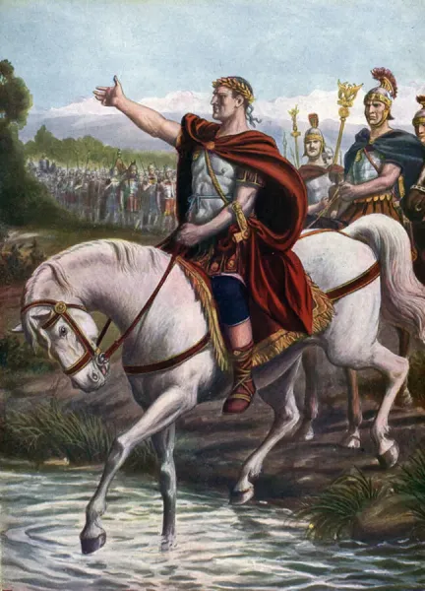
SECTION 66 IT ACT: A JOKE
No remedies for Data Breach
Lacks clear provisions on privacy protection
Phishing is not covered
Does not regulate all types of unauthorized access or data misuse
3 Year Imprisonment with 5 Lakhs – only if convicted
DPDP is not effective, though implemented
CAESAR CROSSING THE RUBICON

Slide 12
END OF PART 1

Slide 13

PHISHING (PHaaS)
Typo-Squatted Domains
Homoglyph Attacks
Targeted entity’s HTML Page on Sale/Open for Phishing on Dark/Deep Web
AI Toolkits to help Phishing to a newer level
Phishing Kits: Mamba, Tycoon, Darcula, Lighthouse, Evilgynx and much more
Grave Danger: BEC (AI Live Example)
REFERENCE ARTICLES
https://medium.com/coinmonks/sbi-yono-phishing-scam-criminals-collecting-user-information-4e479a17b6e1
https://theravenfile.com/2024/12/04/uncovering-icici-phishing-campaign-new-fraud-app-found/

Slide 14
RANSOMWARE:
NAVIGATING DLS & NEGOTIATION PANEL

Slide 15
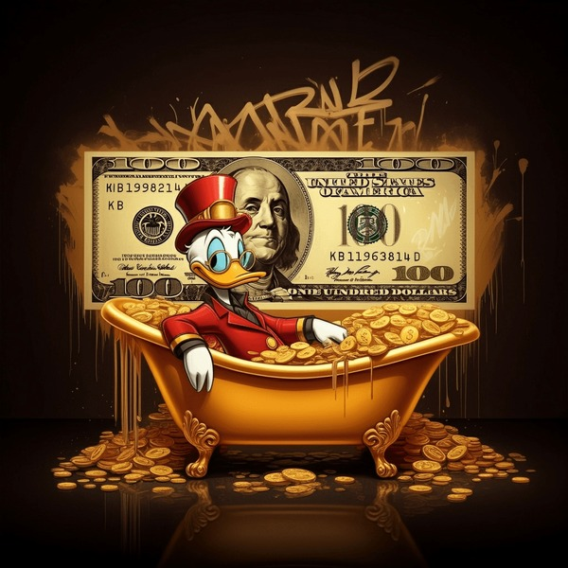
RANSOMWARE
Popular Ransomwares like Qilin, Play or Clop still on surge targeting potential victims on regular basis
Most of the Ransomware does not target CIS Nations: RU, BY, KZ, AM, AZ, KY, MD, UZ, TM
Only few countries have stringent laws for Cybercrime
Most Ransomware Group gains access via Phishing in Corporate Environment
Some of the reputed groups use 0-days against their targets
Ransomware Operators post breaches on their DLS on Dark Web
LIVE EXAMPLE
MD5: fc5be86c846e93b0a65dd18849205514
Ransomware: AKIRA

Slide 16
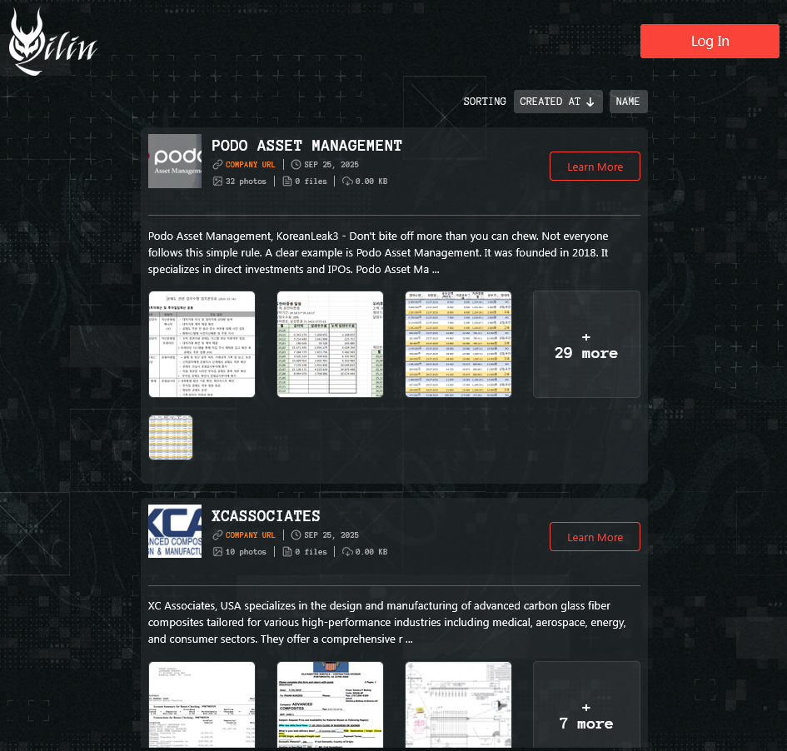
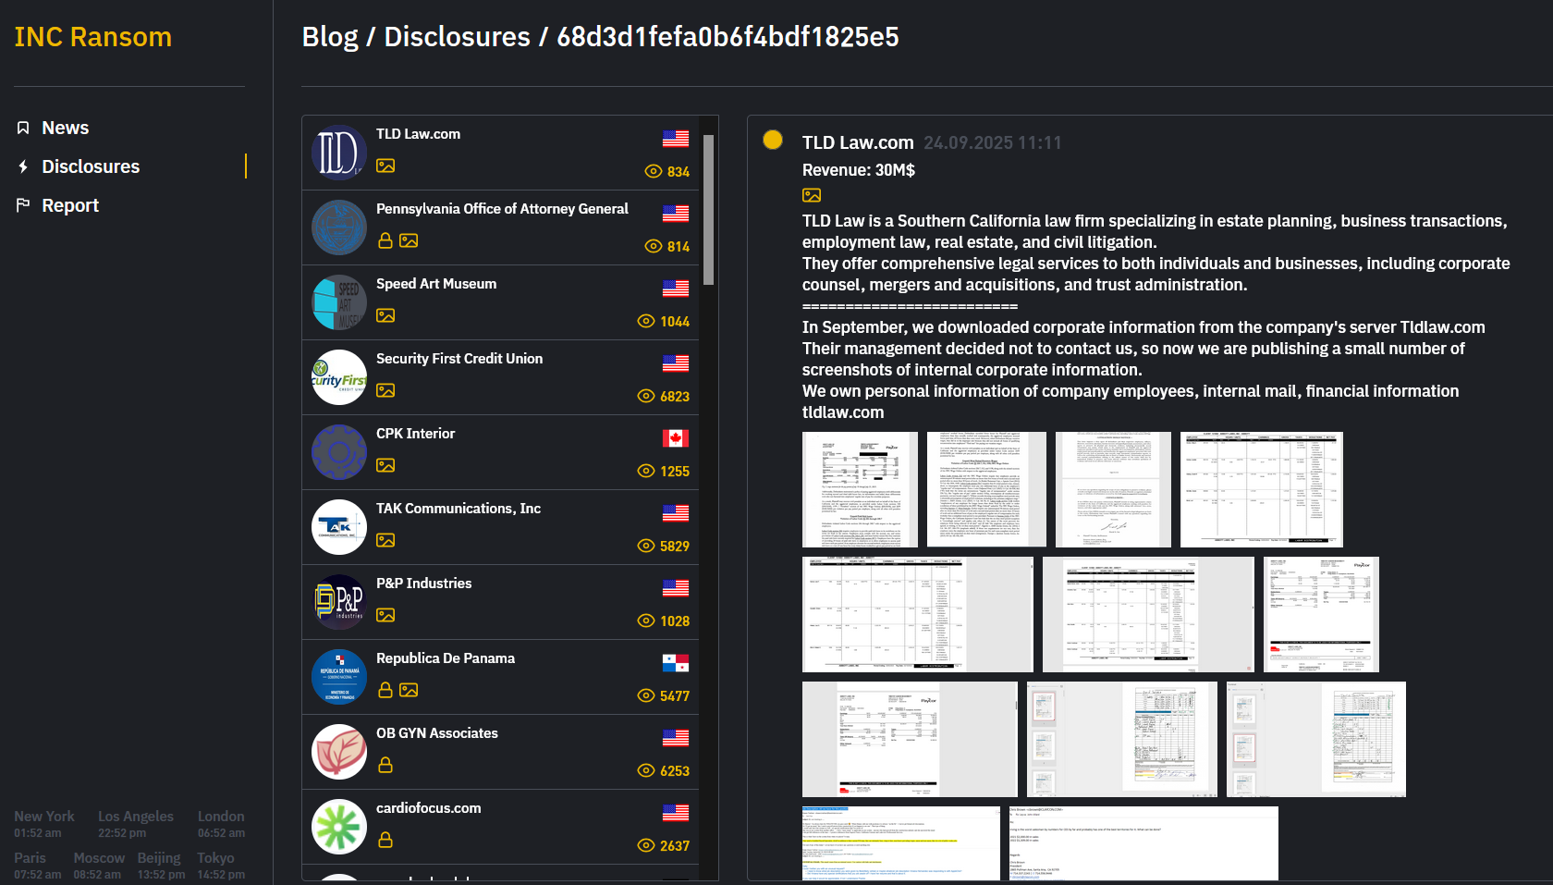
RANSOMWARE DLS
INC Group
Qilin Group

Slide 17
LIVE RANSOMWARE DLS WALKTHROUGH
worldleaksartrjm3c6vasllvgacbi5u3mgzkluehrzhk2jz4taufuid.onion
Ransomware: WORLD LEAKS
mbrlkbtq5jonaqkurjwmxftytyn2ethqvbxfu4rgjbkkknndqwae6byd.onion
Ransomware: PLAY
Some Ransomware leaks re-appears after years; compiling it as a single breach.

Slide 18
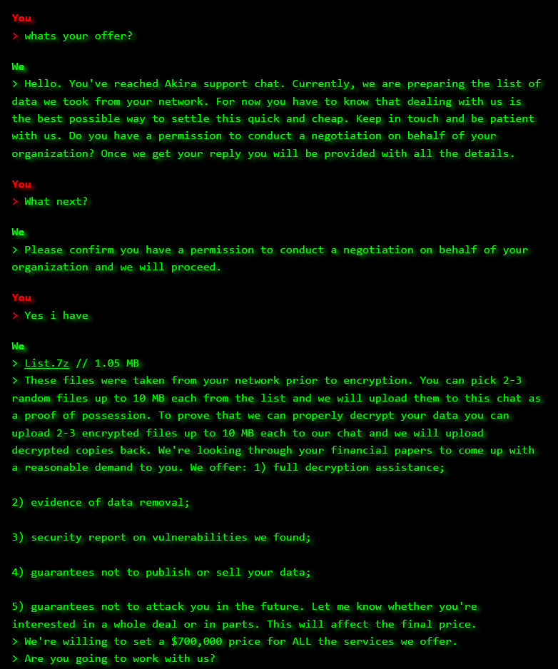
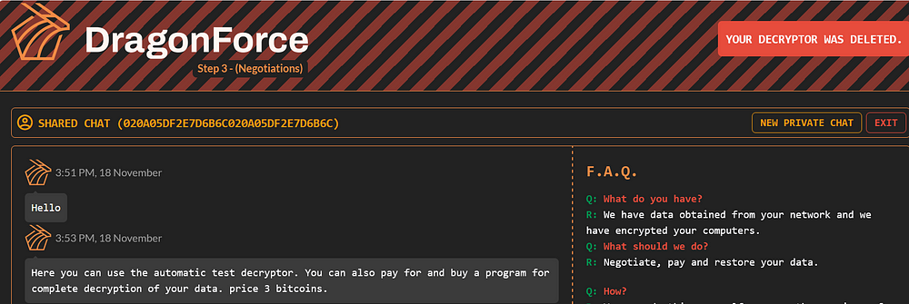
RANSOMWARE CHATS
DRAGONFORCE PORTAL
REFERENCE ARTICLE
https://www.pinsentmasons.com/out-law/news/most-nations-have-weak-laws-against-cybercrime
https://theravenfile.com/2025/09/23/gunra-ransomware-what-you-dont-know/
AKIRA CHAT

Slide 19

CORPORATE STORY TIME
Not all CISOs are smart
Dark Web is different for each ones
Every Intel tells something – Technical, Political or MO
Security Companies: Only few are legit
FOLLOW ME
WEB: theravenfile.com
TWITTER/X: RakeshKrish12
GITHUB: TheRavenFile
LI: rakesh-krishnan-6179a94b

Slide 20

THANK YOU 🐦‍⬛
ANY QUESTIONS?

Slide 21


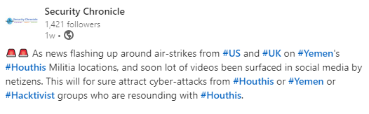


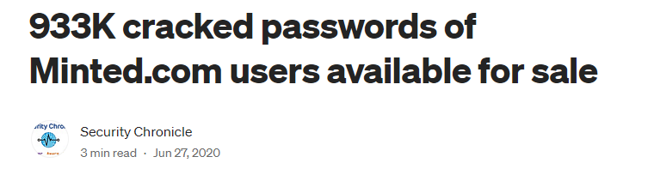
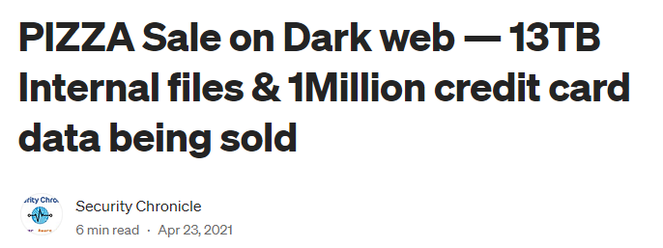
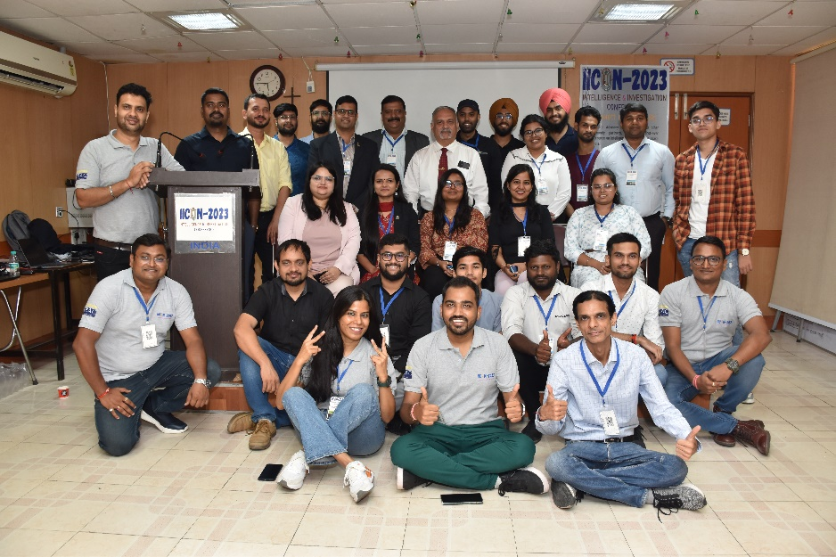
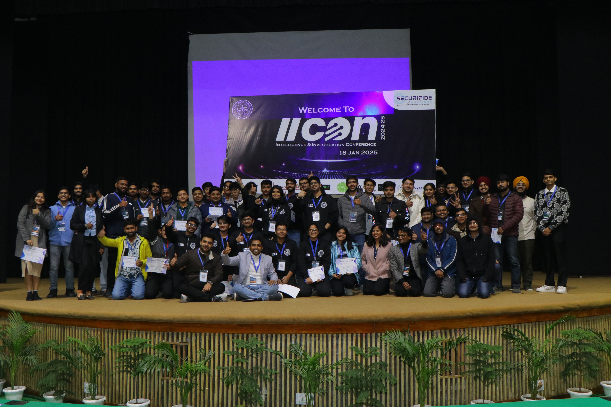
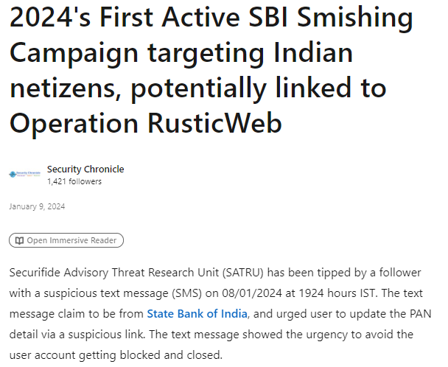
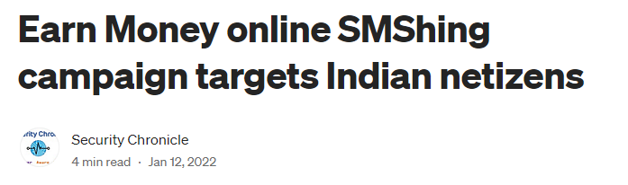
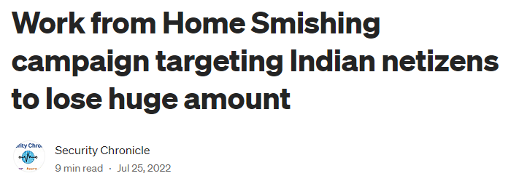
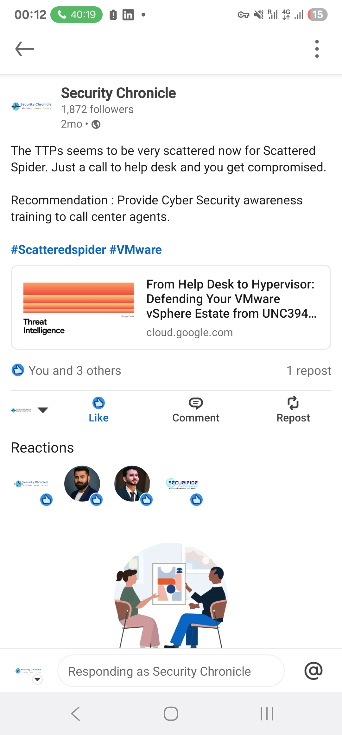
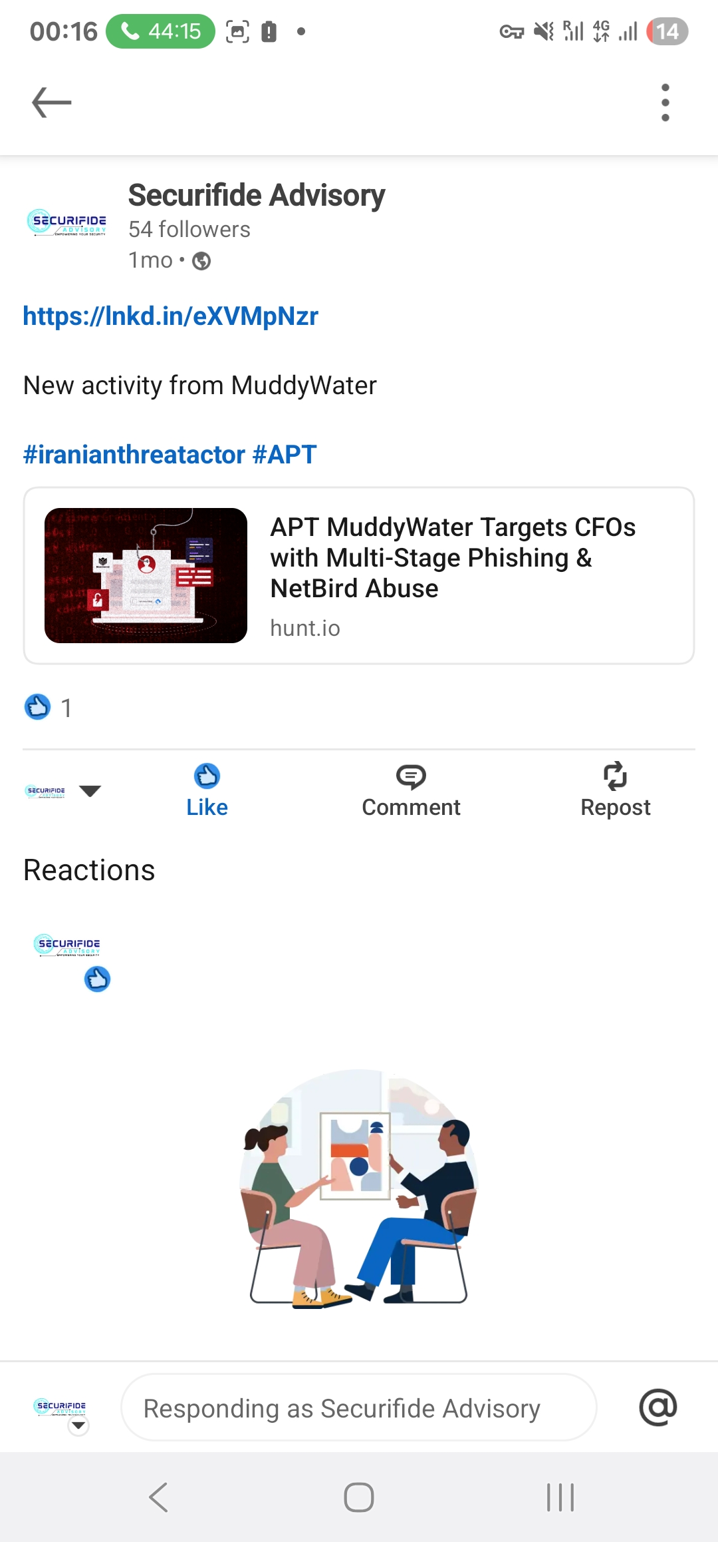

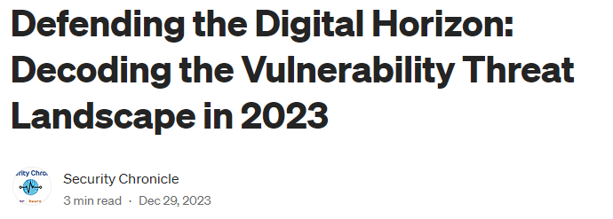



ABOUT THE PROJECT
5 years ago started a project to educate, aware the netizens on security threats and risks – Security Chronicle
Security Chronicle is part of Securifide Advisory, which is on a mission to empower individuals and organizations with the knowledge and skills needed to navigate the complex realm of information security.
Formed a dedicated team of researchers (SATRU), which frequently perform investigations to keep internet a safer place.
Started an initiative, IICON [Intelligence & Investigation Conference], platform for students, InfoSec aspirants, professionals, & leaders to come together under one roof to connect, collaborate, learn & innovate.
Started Training & Workshops to empower professionals with Hands-on experience to excel in information security.
secuifideadvisory.com
Securifide Advisory
Security Chronicle
Security Chronicle
@SecurChronicle

